Slide 1
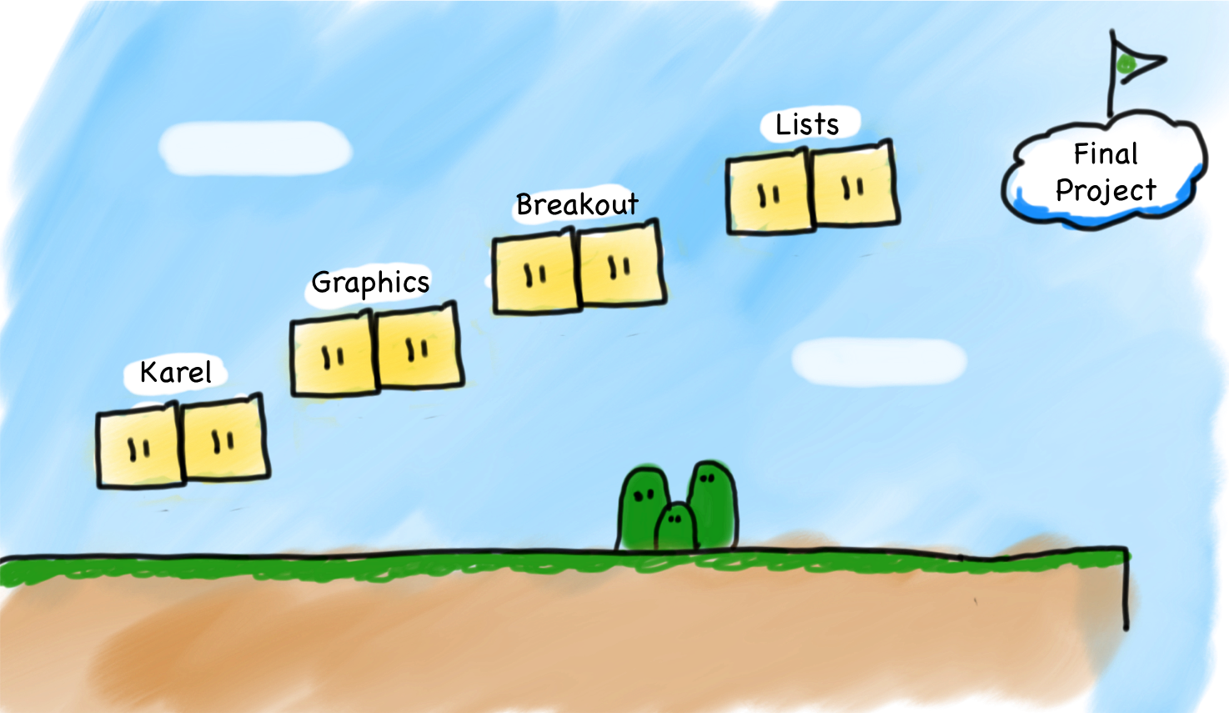
Where Are We In the Class

Slide 2

Where Are We In the Class

Slide 3
Where Are We In the Class

Slide 4
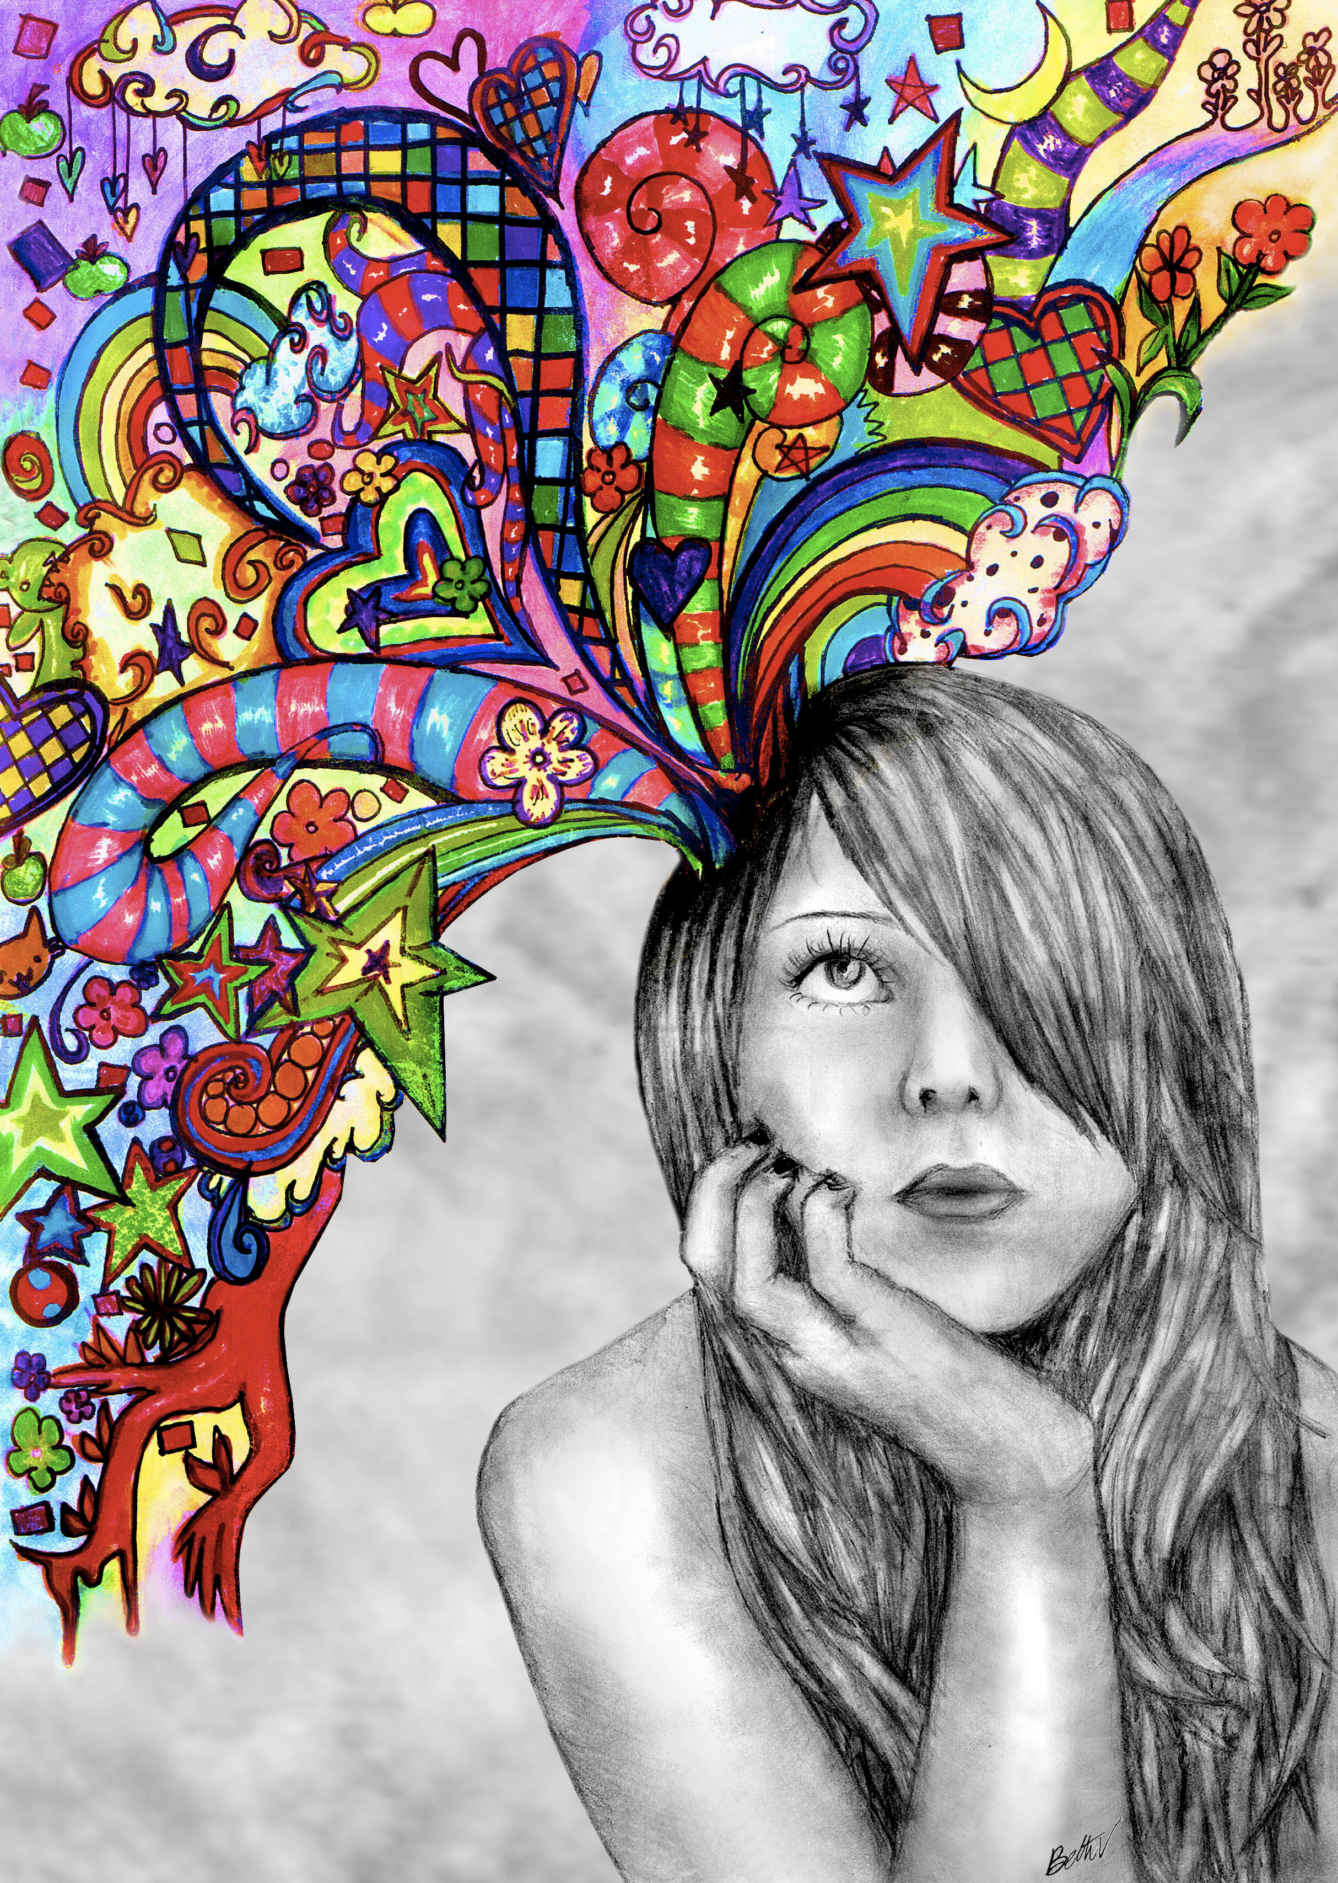
Final Project

Slide 5
Schedule
Today
Tomorrow
9am
9am
Artificial Intelligence
Final Project
Final Project
Lunch
Lunch
Last Lecture
Final Project
1:30pm
Review of Projects
Final Project
Break
3pm
Break
End of Course Ceremony
4pm
Final Project
6pm

Slide 6
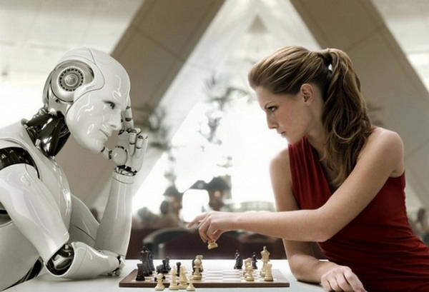
The Future of Robots and Artificial Intelligence

Slide 7


Four Prototypical Trajectories
There is something going on
in the world of AI

Slide 8
Four Prototypical Trajectories
Something big (for us)…

Slide 9
Four Prototypical Trajectories
[suspense]

Slide 10
Where is my robot?

Slide 11
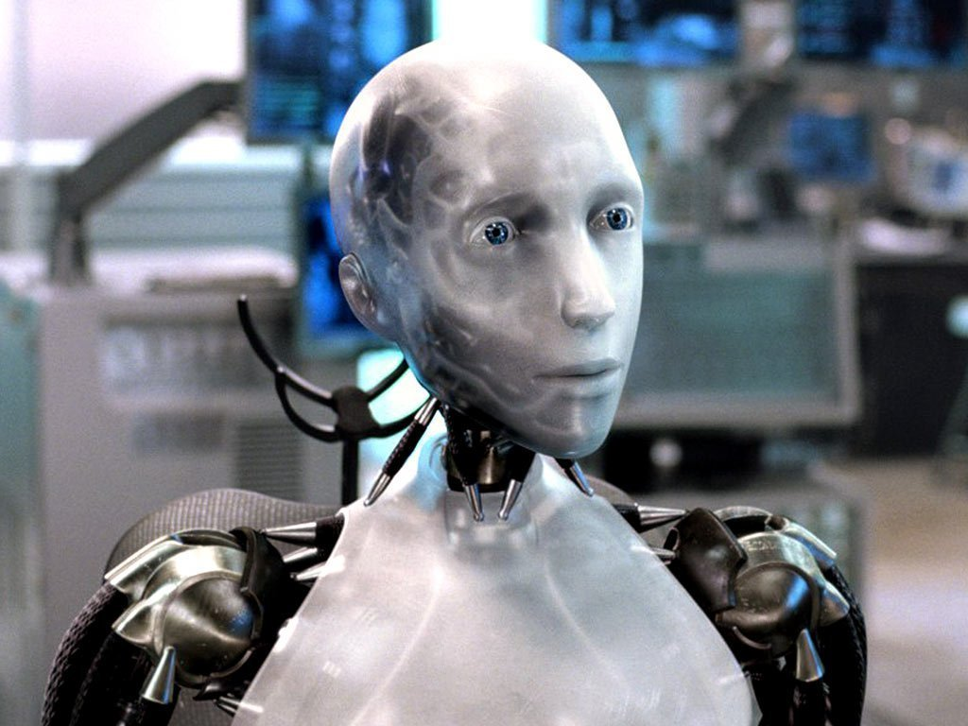
Sci-Fi Has Promised Me Robots

Slide 12
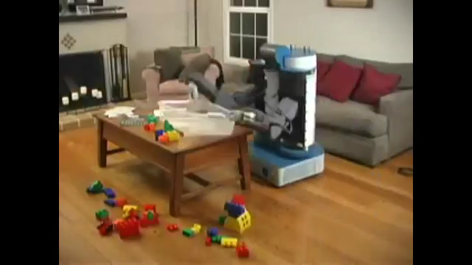
House Cleaning Robot

Slide 13
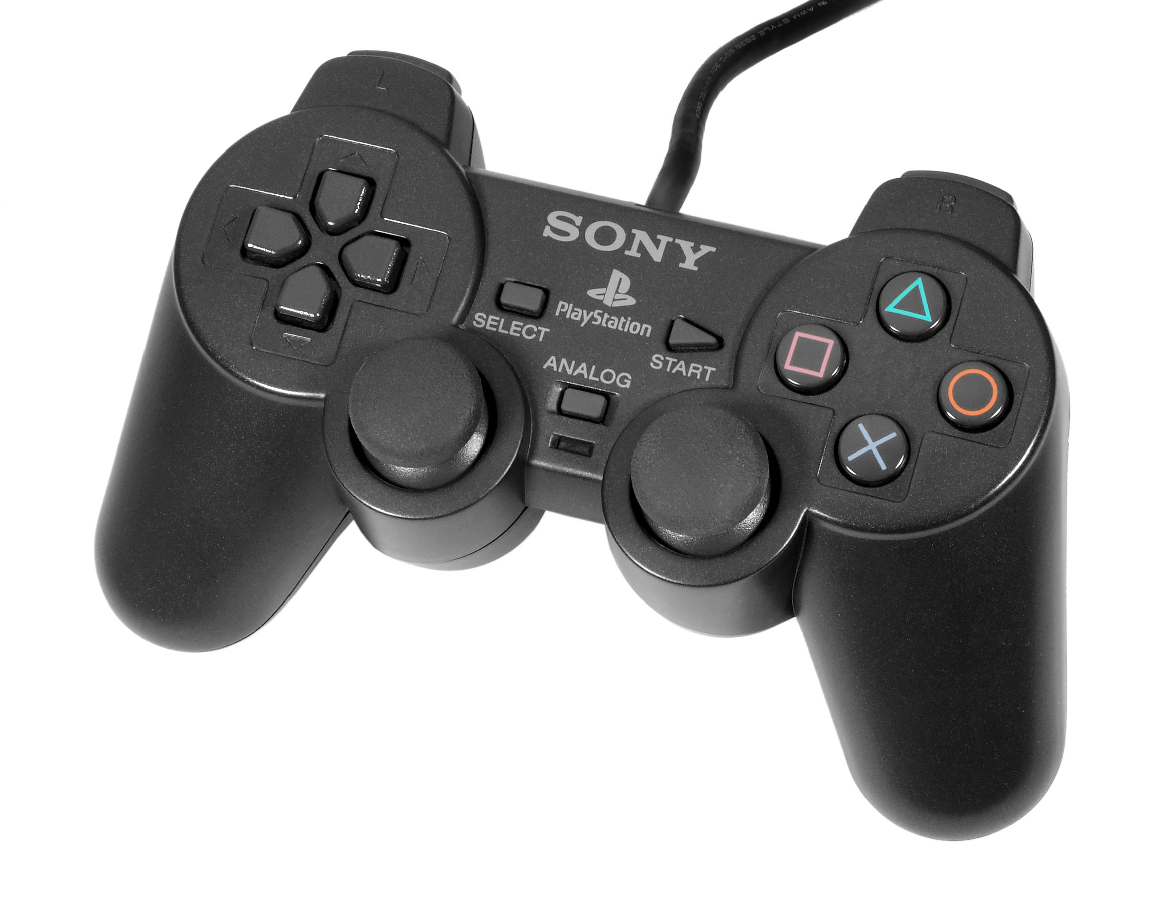
House Cleaning Robot

Slide 14
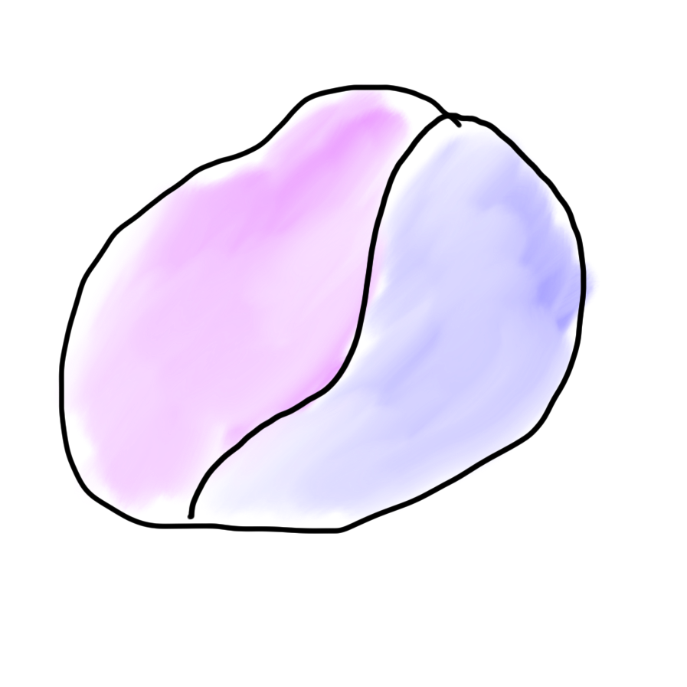
Robots?
Mind
Body

Slide 15

Robots?
Mind
Body

Slide 16
What is AI?

Slide 17
[suspense]

Slide 18
AI: The study and design of intelligent agents

Slide 19

Volunteer

Slide 20
Computer
programs
AI: The study and design of intelligent agents
Better than
chance
As well as
humans

Slide 21
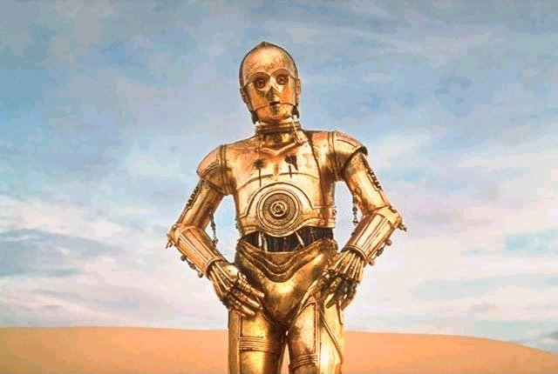
Brief History

Slide 22
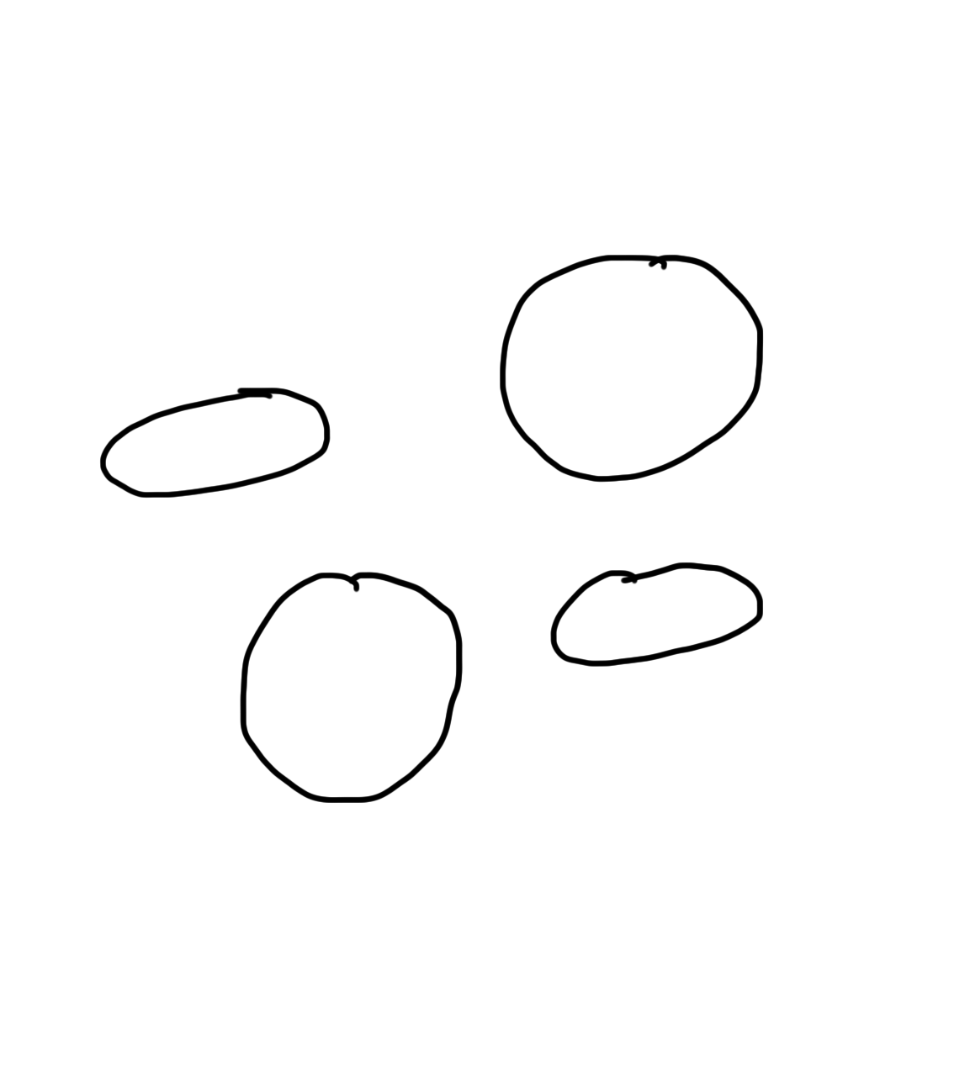
Narrow Intelligence
Translate
Turkish
Play Chess
Play Breakout
Drive a
Car

Slide 23
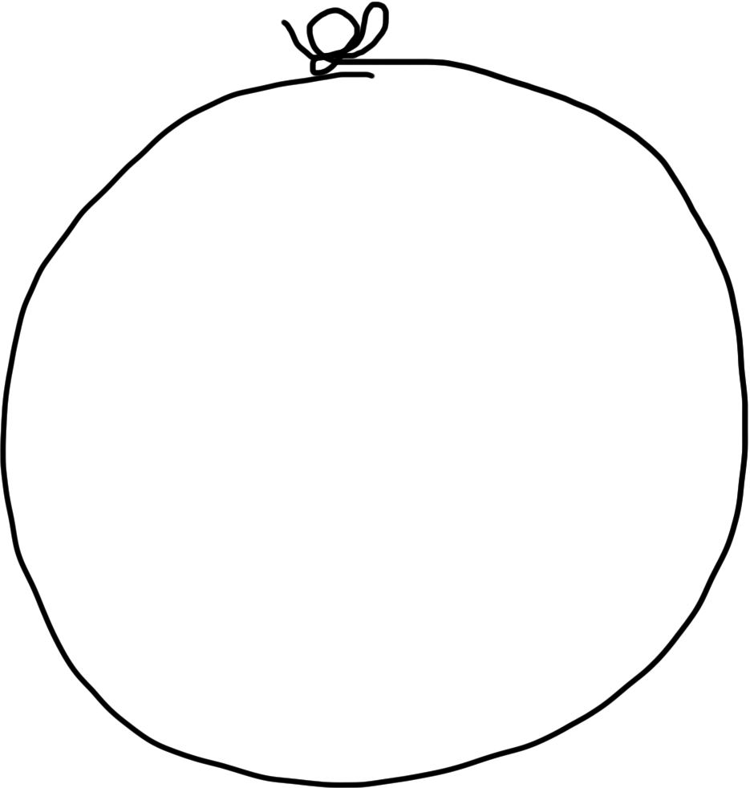
General Intelligence
Translate
Turkish
Play Chess
Play Breakout
Drive a
Car

Slide 24
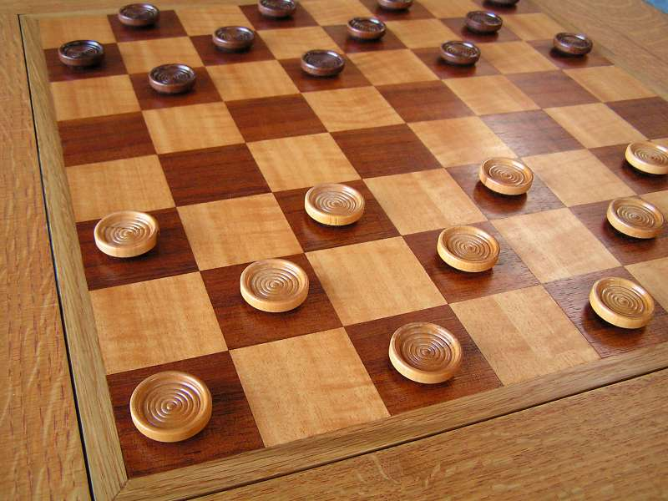
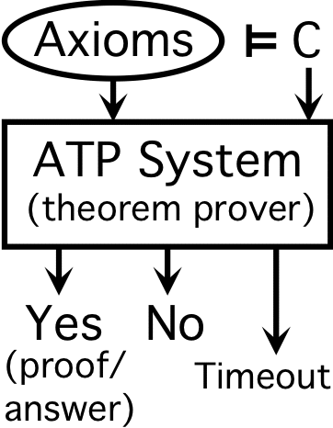
Early Optimism 1950
1952
1955

Slide 25
Early Optimism 1950
“Machines will be capable, within twenty years, of doing any work a man can do.”
–Herbert Simon, 1952

Slide 26
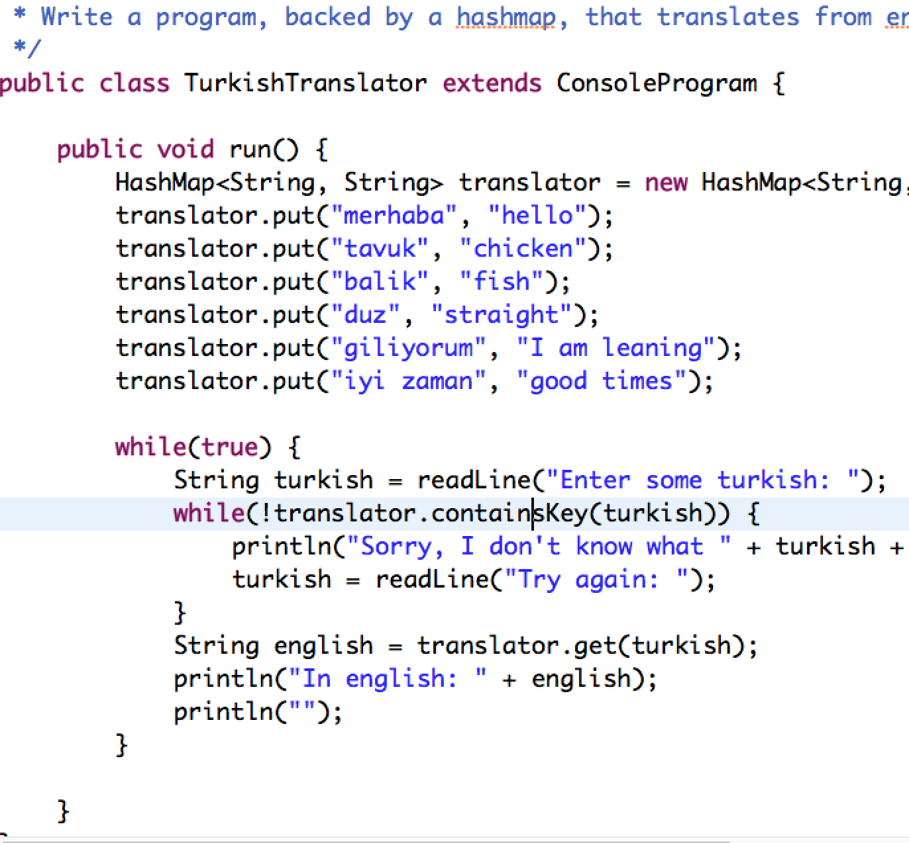
AI = Complex Programs

Slide 27
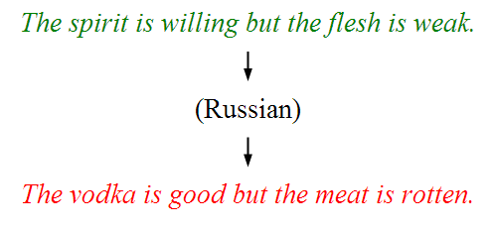
Underwhelming Results 1950s to 1980s
The world is too complex

Slide 28

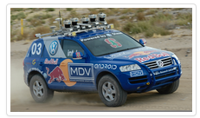

Big Milestones Pt 1
1997 Deep Blue
2005 Stanley
2011 Watson

Slide 29


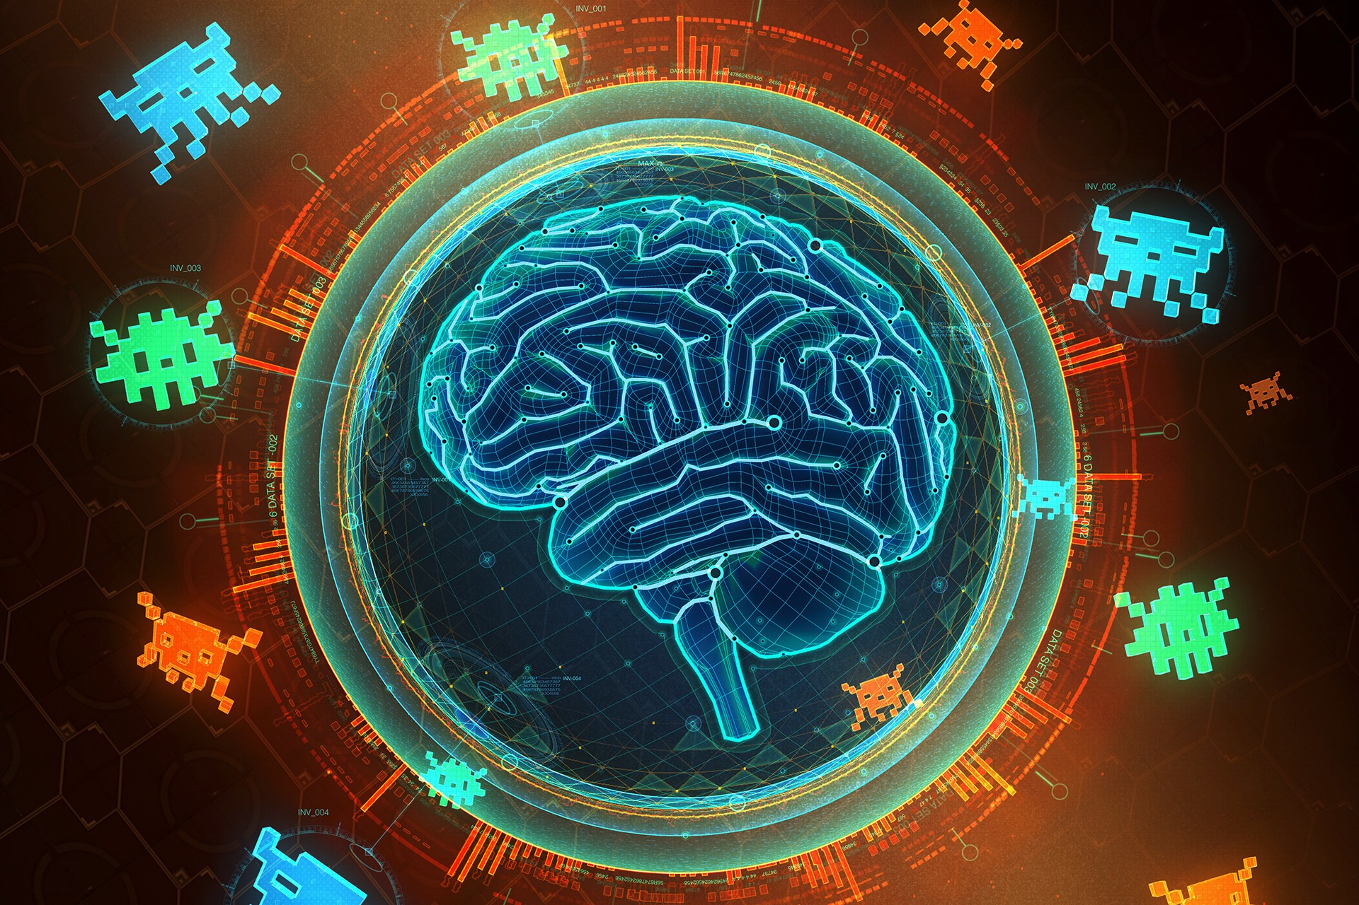
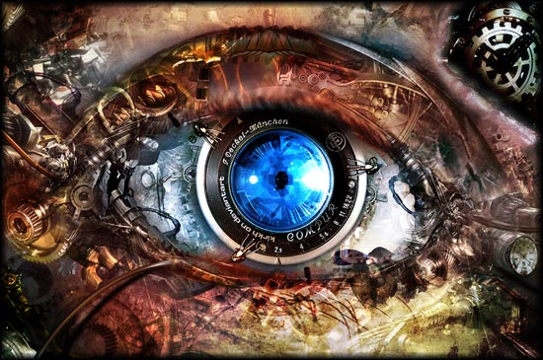
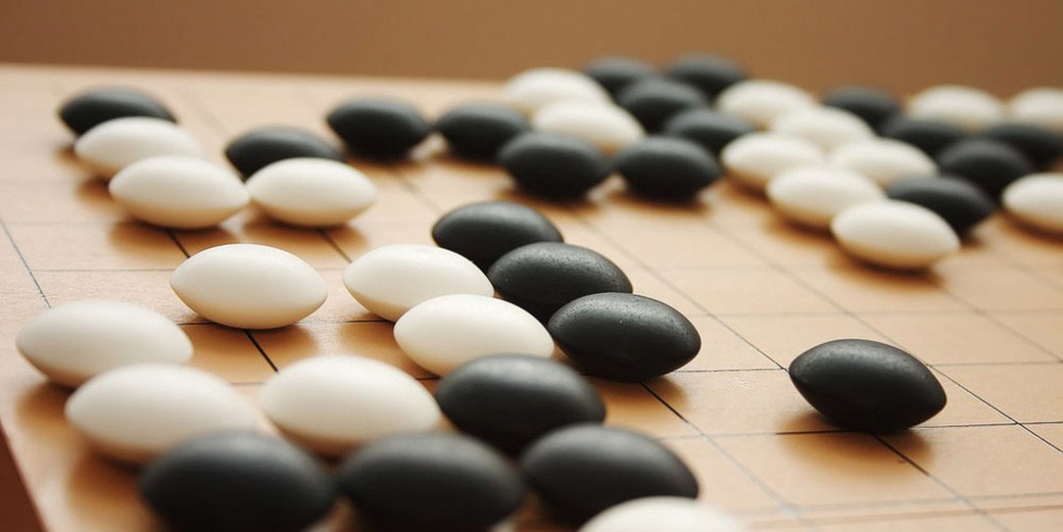
Big Milestones

Slide 30
Told Vision Was 30 Years Out

Slide 31
Told Speech Was 30 Years Out
Almost perfect…

Slide 32
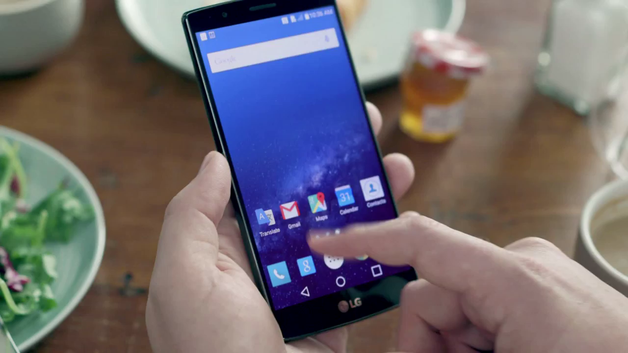
Huge Progress

Slide 33
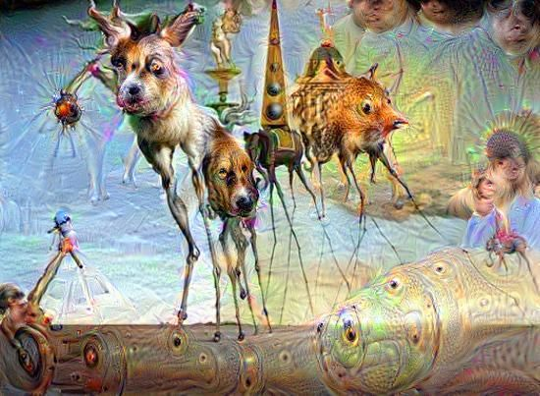
Computers Making Art

Slide 34
What is going on?

Slide 35
Story of Modern AI

Slide 36
Started With Neuroscience

Slide 37
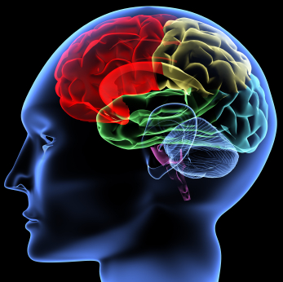
The hypothesis
One Algorithm Hypothesis
Much of perception in the brain can be explained with a single learning algorithm.
[Andrew Ng]

Slide 38

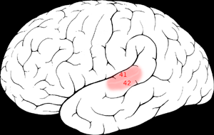

One Learning Algorithm
One Algorithm Hypothesis
Auditory Cortex
Auditory cortex learns to see
[Roe et al., 1992]
[Andrew Ng]

Slide 39
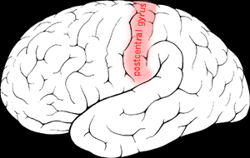

One Algorithm Hypothesis
Somatosensory Cortex
Somatosensory cortex learns to see
[Metin & Frost, 1989]
[Andrew Ng]

Slide 40
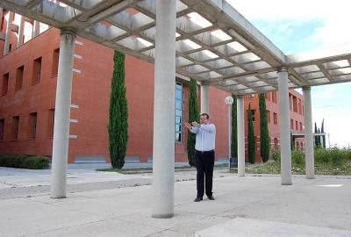
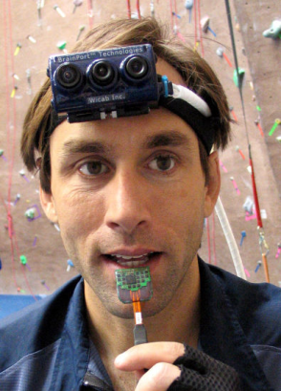
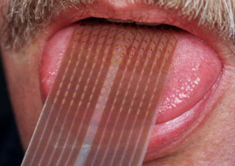
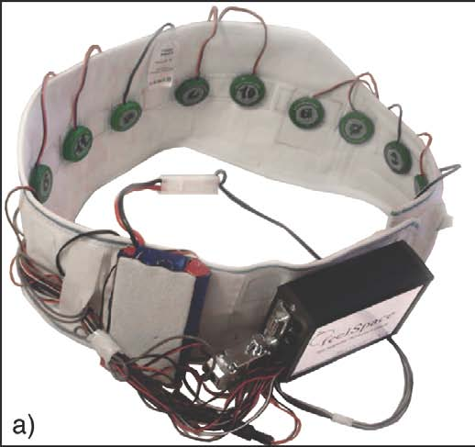
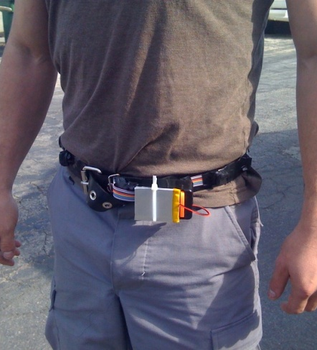
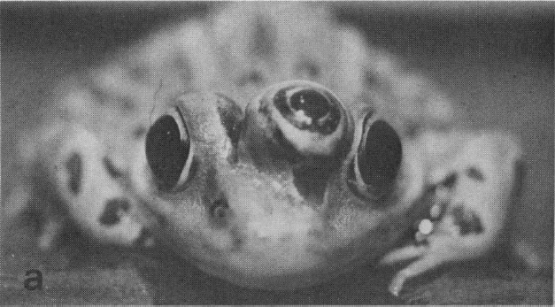
Sensor Representations
Seeing with your tongue
Human echolocation (sonar)
Haptic belt: Direction sense
Implanting a 3rd eye
[BrainPort; Welsh & Blasch, 1997; Nagel et al., 2005; Constantine-Paton & Law, 2009]

Slide 41
Two Great Ideas
1. Artificial Neurons
2. Learn by Example

Slide 42
Two Great Ideas
1. Artificial Neurons
2. Learn by Example

Slide 43
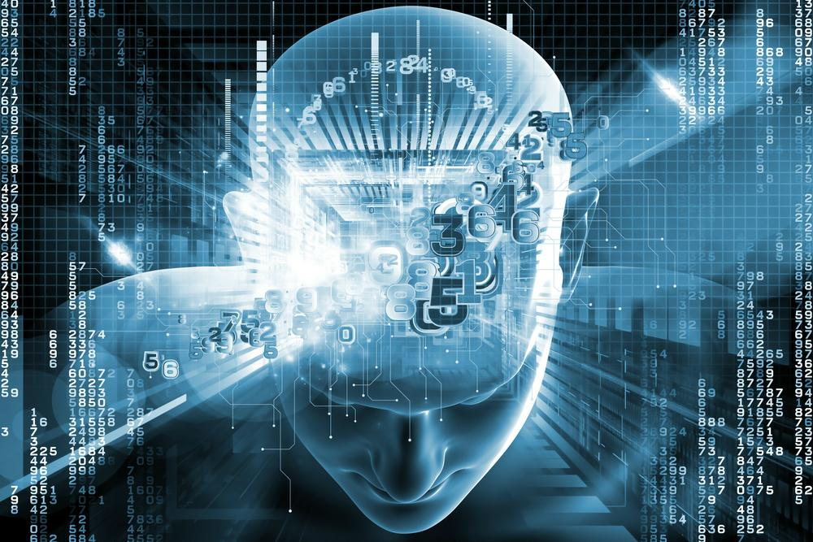
1. Artificial Neurons

Slide 44
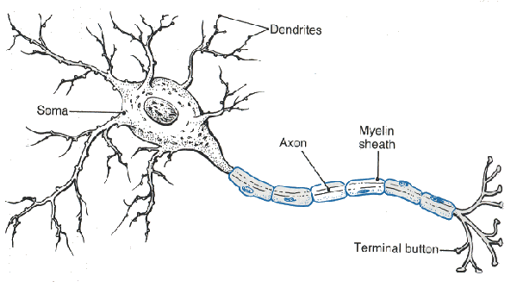
Neuron

Slide 45
Neuron

Slide 46
Neuron

Slide 47
Neuron

Slide 48
Neuron

Slide 49
Some Inputs are More Important

Slide 50
Artificial Neuron
1
2
1
3
6
0.99
-2
0
1
1

Slide 51
Artificial Neuron
1
2
1
3
6
0.99
-2
0
1
1
Input sum = input1 * weight1 +
input2 * weight2 +
input3 * weight3 +
input4 * weight4

Slide 52
Artificial Neuron
1
2
1
3
6
0.99
-2
0
1
1
Input sum = 1 * 2 +
1 * 3 +
0 * -2 +
1 * 1

Slide 53
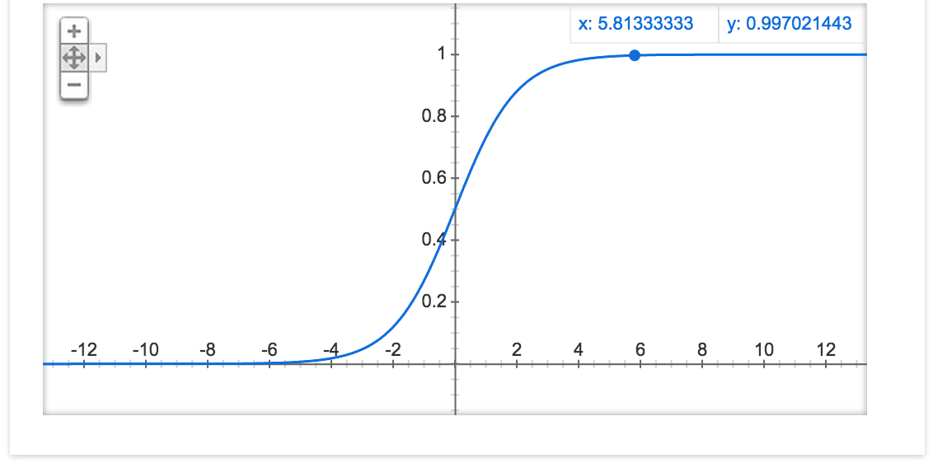
Sigmoid Function
1
2
1
3
6
0.99
-2
0
1
1

Slide 54
Java Demo

Slide 55
Put Many Together

Slide 56
Put Many Together

Slide 57
Put Many Together

Slide 58
Put Many Together

Slide 59
Make It Useful

Slide 60

Make It Useful

Slide 61
Make It Useful

Slide 62
Make It Useful
This means it’s a picture of the number 4

Slide 63

Make It Useful
This means it’s a picture of the number 6

Slide 64

You!

Slide 65
Program Artificial Neurons
ArrayList<Double> weights;
ArrayList<Double> inputs;

Slide 66
Two Great Ideas
1. Artificial Neurons
2. Learn by Example

Slide 67
Two Great Ideas
1. Artificial Neurons
2. Learn by Example

Slide 68
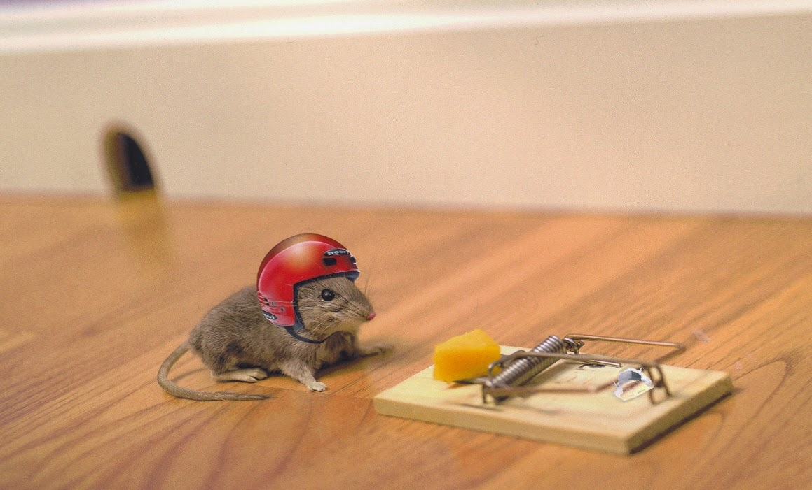
2. Learn From Experience

Slide 69

Learn by Example

Slide 70
When We Are Wrong…
This means it’s a picture of the number 6

Slide 71
Adjust Weights
This means it’s a picture of the number 6

Slide 72


Visualize the Weights
object models
object parts
(combination
of edges)
Training set: Aligned
images of faces.
edges
pixels
[Honglak Lee]

Slide 73
Woah… that’s like a brain…

Slide 74
True.

Slide 75
Decomposition
Mountain Karel
Climb Up Mountain
Step Up
Pick Beeper
Climb Down Mountain
Step Down
Notes:
He looks like an old machintosh machine.
Hes got legs… one sticks out the back. That’s just the way it is.

Slide 76
Complex Programs Vs Neural Networks
Performance
Time
2012
Now
Notes:
NVIDIA or ATI will be future of AI. Probably NVIDIA.

Slide 77

Google Brain

Slide 78
Google Brain
1 Trillion Artificial Neurons

Slide 79

Watched YouTube

Slide 80
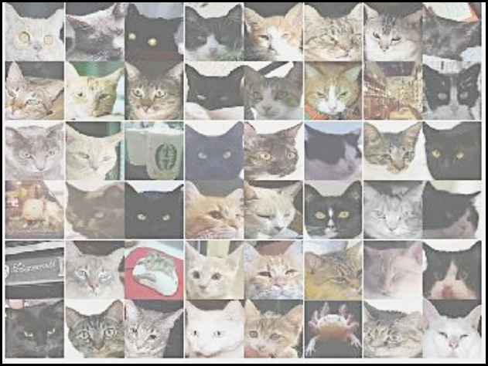

A Neuron That Fires When It Sees Cats
Top stimuli from the test set
Optimal stimulus
by numerical optimization
Le, et al., Building high-level features using large-scale unsupervised learning. ICML 2012

Slide 81


Slide 82





Other Neurons
Neuron 1
Neuron 2
Neuron 3
Neuron 4
Neuron 5
Le, et al., Building high-level features using large-scale unsupervised learning. ICML 2012
Input to another layer above
(image with 8 channels)
Number of output
channels = 8
LCN Size = 5
H
Pooling Size = 5
Number
of maps = 8
One layer
W
RF size = 18
Number of input
channels = 3
Image Size = 200

Slide 83

Autonomous Tutor

Slide 84

Story of Riley
1
10
20
30
40
50
Exercise index
Exercise Type:
Answer:
Solving for x-intercept
Correct
Solving for y-intercept
Incorrect
Graphing linear equations
Square roots
Slope of a line

Slide 85
Story of Riley
1
10
20
30
40
50
Exercise index
Exercise Type:
Answer:
Solving for x-intercept
Correct
Solving for y-intercept
Incorrect
Graphing linear equations
Square roots
Slope of a line

Slide 86
Story of Riley
1
10
20
30
40
50
Exercise index
Exercise Type:
Answer:
Solving for x-intercept
Correct
Solving for y-intercept
Incorrect
Graphing linear equations
Square roots
Slope of a line

Slide 87
Story of Riley
1
10
20
30
40
50
Exercise index
Exercise Type:
Answer:
Solving for x-intercept
Correct
Solving for y-intercept
Incorrect
Graphing linear equations
Square roots
Slope of a line

Slide 88
Story of Riley
1
10
20
30
40
50
Exercise index
Exercise Type:
Answer:
Solving for x-intercept
Correct
Solving for y-intercept
Incorrect
Graphing linear equations
Square roots
Slope of a line

Slide 89
Story of Riley
1
10
20
30
40
50
Exercise index
Exercise Type:
Answer:
Solving for x-intercept
Correct
Solving for y-intercept
Incorrect
Graphing linear equations
Square roots
Slope of a line

Slide 90
Story of Riley
1
10
20
30
40
50
Exercise index
What should Riley do next?
Exercise Type:
Answer:
Solving for x-intercept
Correct
Solving for y-intercept
Incorrect
Graphing linear equations
Square roots
Slope of a line

Slide 91
Story of Riley
1
10
20
30
40
50
Exercise index
51
60
70
80
Exercise index
Exercise Type:
Answer:
Solving for x-intercept
Correct
Solving for y-intercept
Incorrect
Graphing linear equations
Square roots
Slope of a line

Slide 92


Four Prototypical Trajectories
There are millions of Rileys
#iamriley

Slide 93
Autonomous Tutor
May 2015
[Chris]

Slide 94
Learns Concept Relationships
Scatter plots
Pythagorean
theorem
Lines
Angles
Functions
Exponents
Systems of
Equations
Line graphs
Fractions

Slide 95
Learns Concept Relationships

Slide 96
Learns Concept Relationships
Finding the x-intercept

Slide 97
Learns Concept Relationships
Finding the y-intercept

Slide 98
Learns Concept Relationships
Slope of a line

Slide 99
Learns Concept Relationships
Graphing
Linear Equations

Slide 100
Learns Concept Relationships
Graphing
Systems of Equations

Slide 101


Research has Been Reproduced
20 million students
per month
2 million students
per month

Slide 102
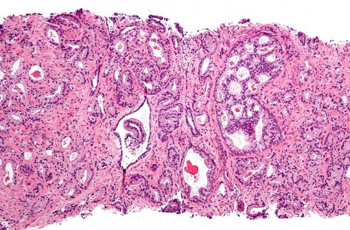
Recognizing Cancer

Slide 103
Didn’t Think This Would Happen

Slide 104
The Last Remaining Board Game ☹

Slide 105
Future of AI
Performance
Time
Now
[Andrew Ng]
Notes:
NVIDIA or ATI will be future of AI. Probably NVIDIA.

Slide 106
Future of AI
Human Intelligence
Performance
Time
Now
[Andrew Ng]
Notes:
NVIDIA or ATI will be future of AI. Probably NVIDIA.

Slide 107
Future of AI
Einstein
Human Intelligence
Performance
Time
Now
[Andrew Ng]
Notes:
NVIDIA or ATI will be future of AI. Probably NVIDIA.

Slide 108
Where is my robot?

Slide 109
… coming soon

Slide 110

Know It So You Can Beat It
Little math

Slide 111
Can you do it?

Slide 112
I explained to you the main components

Slide 113
Not easy…

Slide 114
But yes. You can.

Slide 115
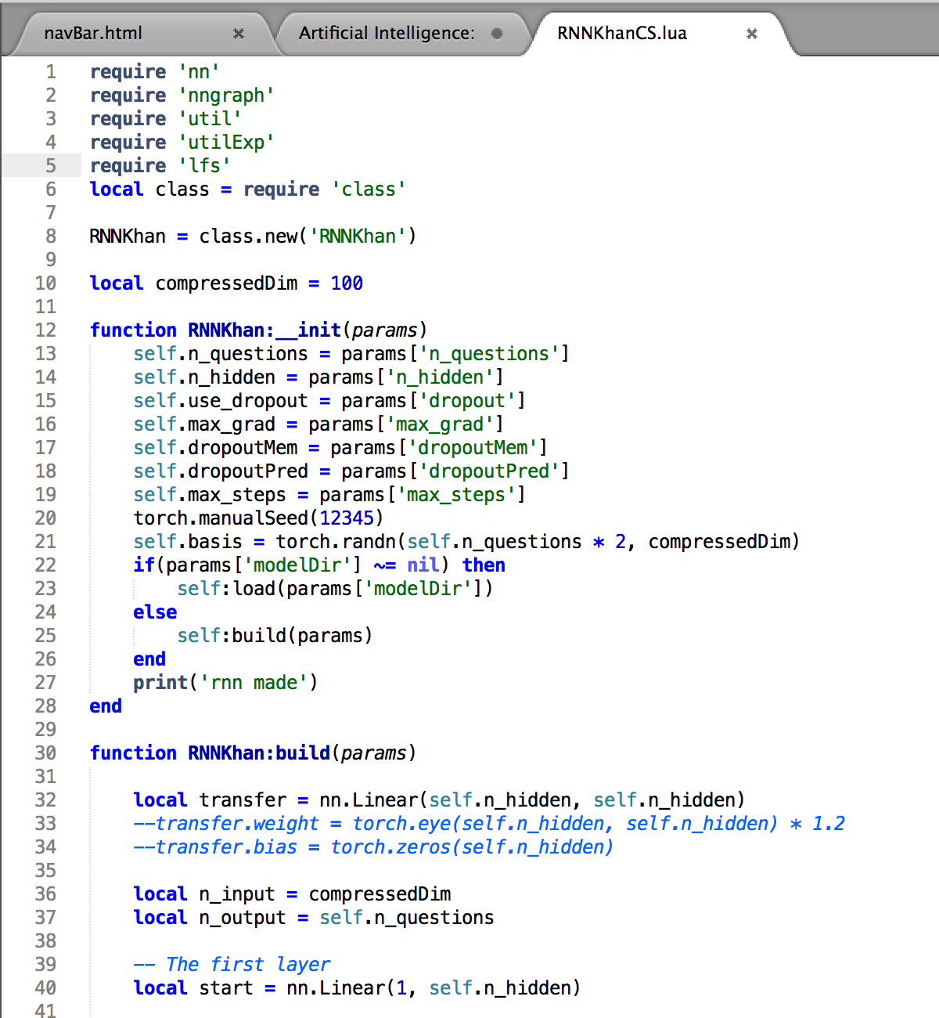
Come See My Code!
390 lines
But yes. You can.
Both Lua and Java

Slide 116
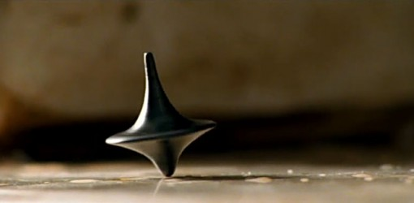
The End?

